Slide 1
Graphics
(how to install)

Slide 2
Gimp
https://www.gimp.org/
Download 2.10.20 (or current version)
(directly)

Slide 3
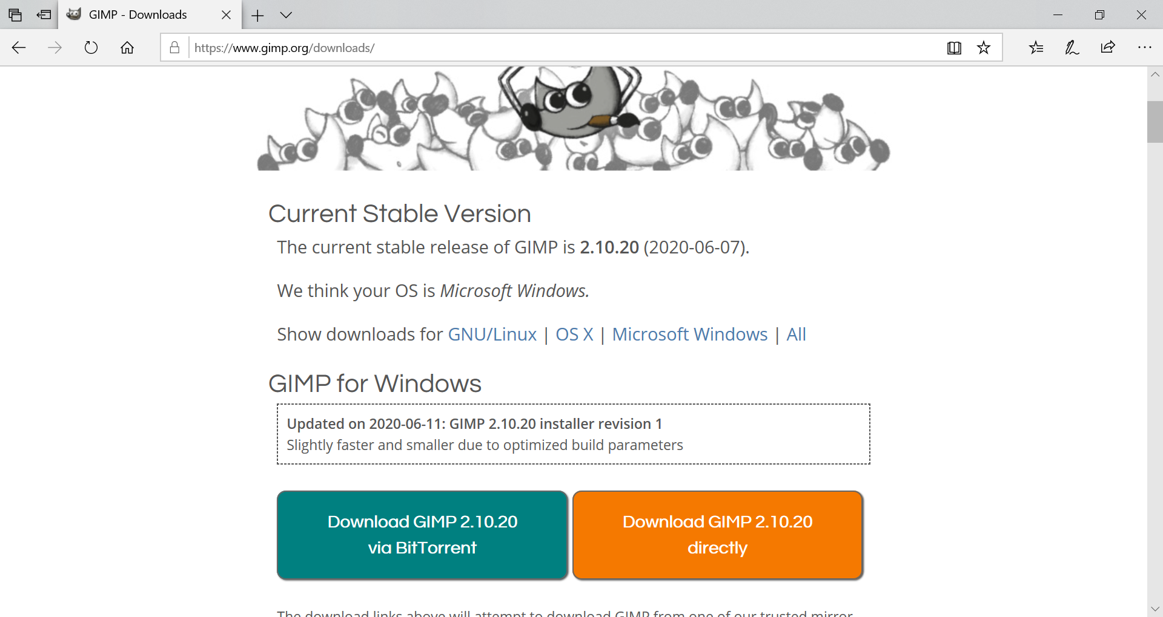

Slide 4
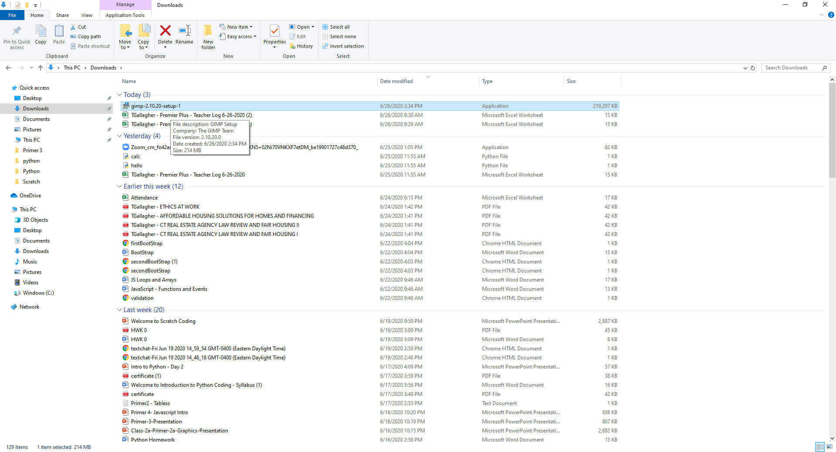
Install Gimp from your Downloads

Slide 5
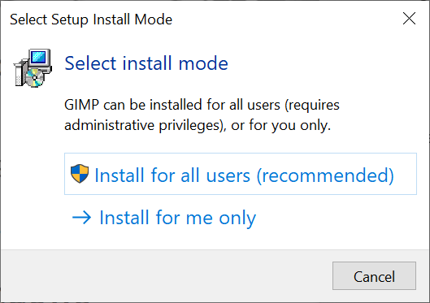
Run the Install
RUN > gimp-2.10.20-setup-1.exe

Slide 6
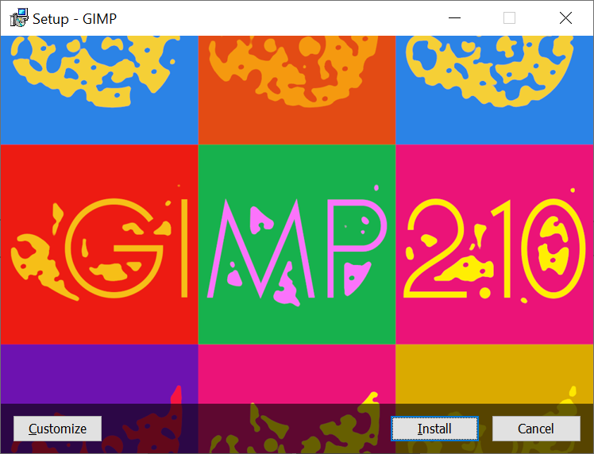
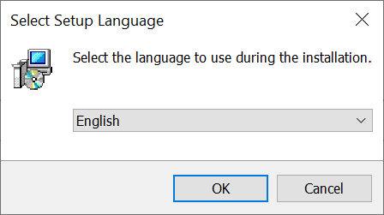
Choose the defaults

Slide 7
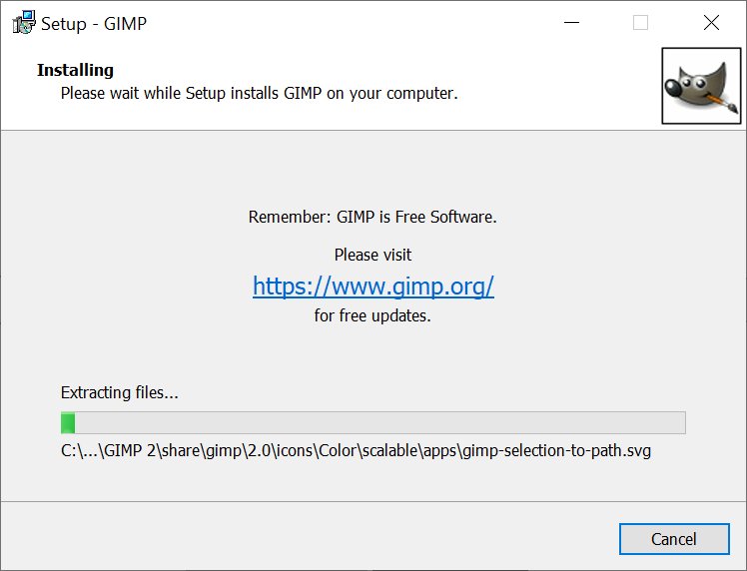
Install Begins

Slide 8
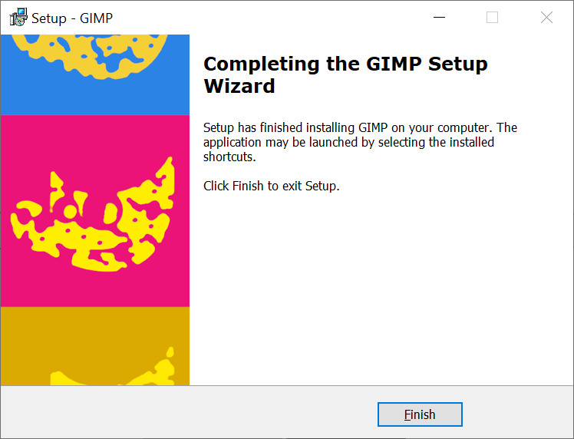
Setup finishes

Slide 9
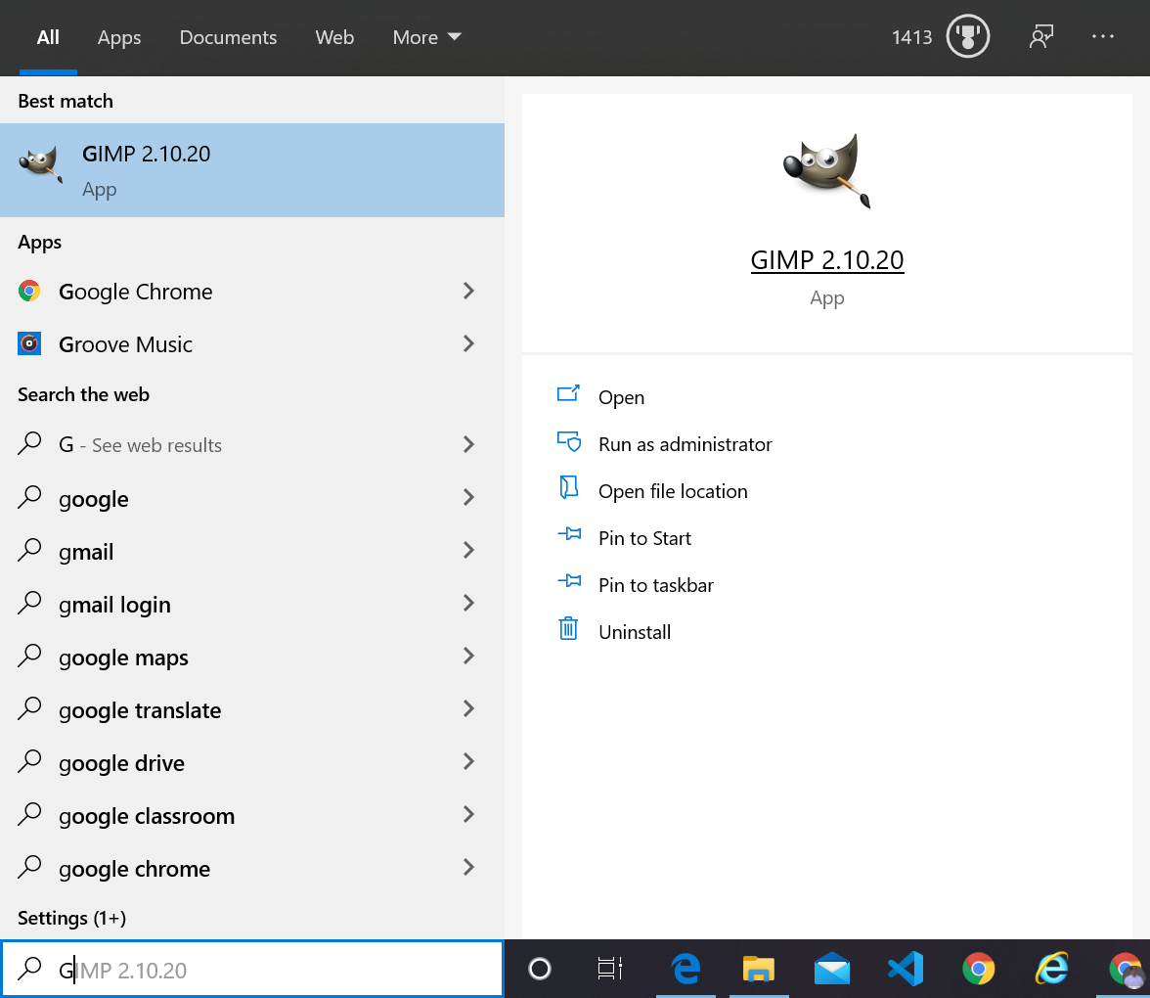
Let’s Launch the App

Slide 10
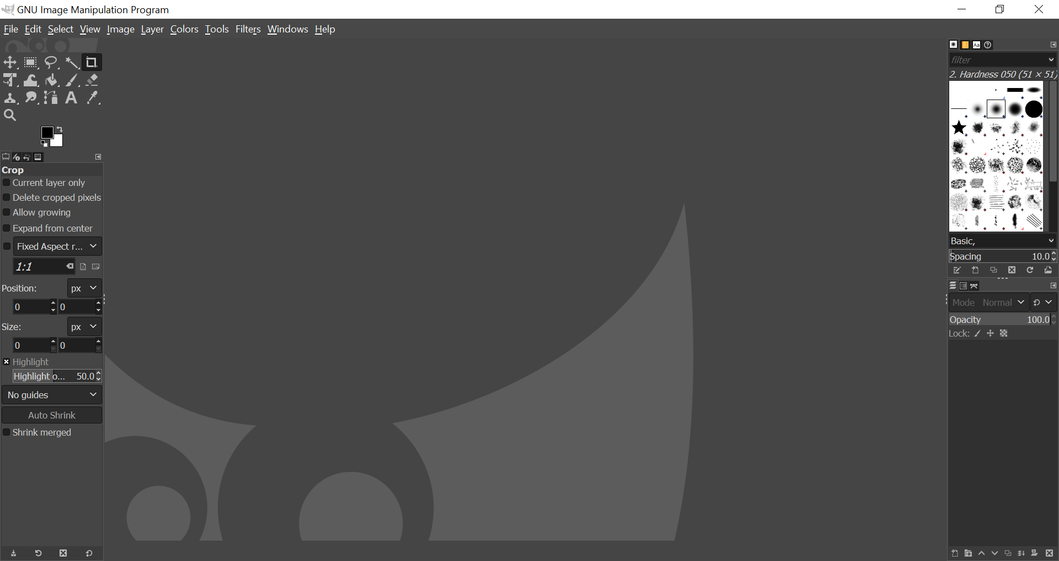
Home Screen – You did it!

